Slide 1
Nitrification in Drinking Water Biofilms

Slide 2
Agenda
Drinking Water Distribution System Background
What are biofilms?
Nitrification
Research questions
Biofilm sampler

Slide 3
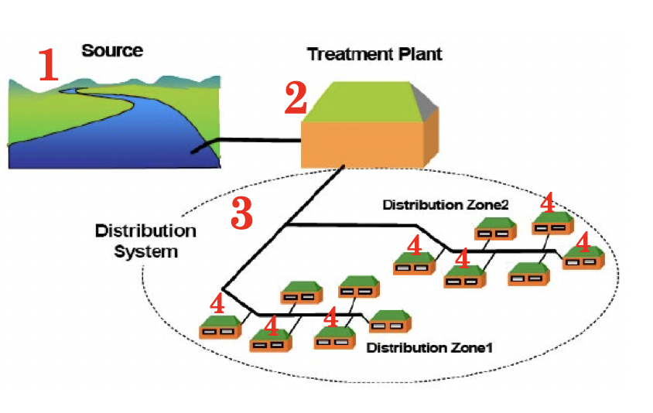
Drinking Water Distribution Systems
Water is pumped from one of two major water sources:
Surface water – Rivers, Lakes, etc.
Ground Water – Collected from wells
Water is treated via various chemical, physical and biological processes to remove contaminants
Water is then distributed throughout a series of interconnected water mains to be delivered to individual homes and businesses
Water then travels through the home plumbing before reaching the tap where you see it
Image source:
http://www.mfe.govt.nz/publications/rma/draft-users-guide-national-environmental-standard-sources-human-drinking-water/2

Slide 4
PWD’s Distribution System

Slide 5
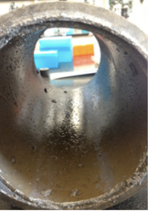
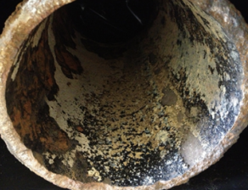
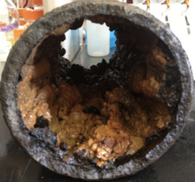
Biofilms in DWDS
Biofilms can grow on any surface – in DWDS it’s pipe walls
Makeup ~90% of biomass in DWDS
Can harbor and create optimal growth conditions for pathogens
Help facilitate nitrification in chloraminated systems
Gomez-Smith, K., LaPara, T. & Hozalski, R. Sulfate Reducing Bacteria and Mycobacteria Dominate the Biofilm Communities in a Chloraminated Drinking Water Distribution System. Environ Sci Technol 49, 8432–40 (2015).

Slide 6
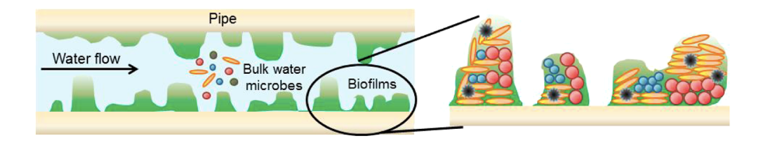
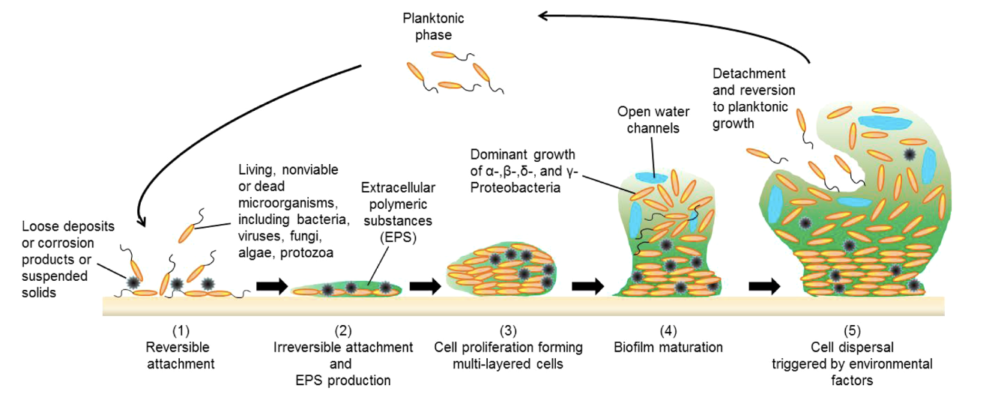
Biofilm growth
Liu, S. et al. Understanding, Monitoring, and Controlling Biofilm Growth in Drinking Water Distribution Systems.Environ Sci chnol 50, 8954–8976 (2016).

Slide 7
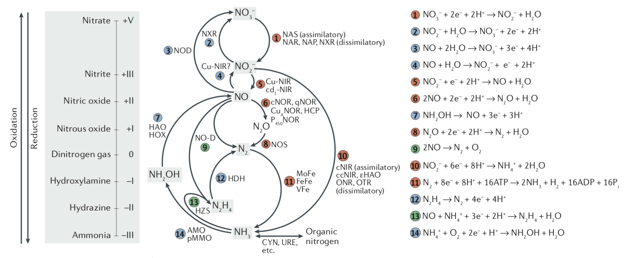
Kuypers, M., Marchant, H. & Kartal, B. The microbial nitrogen-cycling network. Nat Rev Microbiol 16, 263 (2018).

Slide 8


AOB
NOB
NH₃
NO₂
NO₃
$${NH}_{3}+ O_{2}→{NO}_{2}^{−}+3H^{+}+2e^{−}$$
$${NO}_{2}^{−}+ H_{2}O→ {NO}_{3}^{−}+2H^{+}+2e^{−}$$
Nitrification. USEPA, 2002

Slide 9

Where does NH₃ come from in DWDS?
Add figure showing how mono dies off the further away from the plant you are
Add figure showing how rapidly chloramine die off can occur
PWD carries residual NH₃ throughout the DWDS
NH₃ is produced as a result of NH₂Cl auto-decomposition
$$3{NH}_{2}Cl → N_{2}+ {NH}_{3}+3{Cl}^{−}+3H^{+}$$
NH₃ is also produced as a result of increased biological activity –
$$\frac{1}{10}C_{5}H_{7}O_{2}N+ {NH}_{2}Cl+ \frac{9}{10}H_{2}O → \frac{4}{10}{CO}_{2}+ \frac{1}{10}{HCO}_{3}^{−}\frac{11}{10}{NH}_{4}^{+}$$
Nitrification. USEPA, 2002

Slide 10
Ammonia Oxidizing Bacteria

Slide 11
Research Questions
Does the biofilm community in any one location accurately represent the biofilm community at another location in the same area at any given point in time?
Does the flushing strategy implemented change the impact on the nitrifying communities (point flushing vs continuous flushing)?
Does biofilm and nitrifying bacteria accumulate and grow faster when pipes are scoured (or new pipes/coupons inserted) during periods of active nitrification?

Slide 12
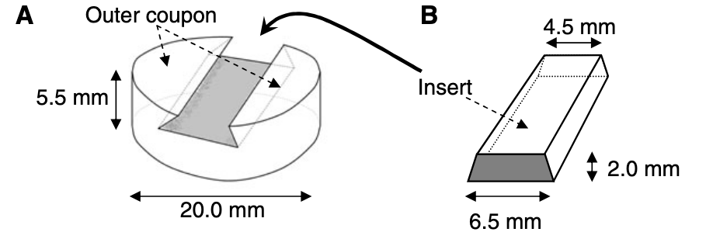
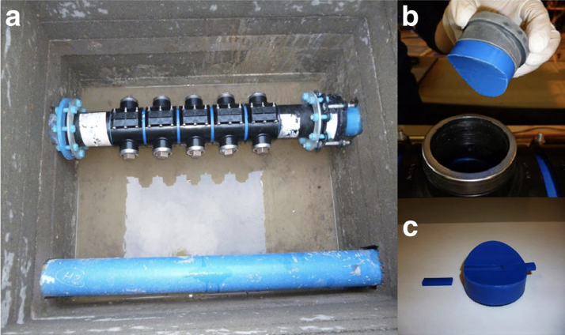
Biofilm Sampler
Based on novel coupon design by Pennine Water Group at University of Sheffield in the UK
Coupons act as part of pipe wall to allow for realistic growth conditions
Will be installed in 2 locations in Philadelphia’s Navy Yard (by the stadiums)
This is an area of known nitrification
Being installed along side two new continuous flushing stations
Deines, P. et al. A new coupon design for simultaneous analysis of in situ microbial biofilm formation and community structure in drinking water distribution systems. Appl Microbiol Biot 87, 749–756 (2010).
Douterelo, I., Jackson, Solomon & Boxall. Microbial analysis of in situ biofilm formation in drinking water distribution systems: implications for monitoring and control of drinking water quality. Appl Microbiol Biot 100,3301–3311 (2016).

Slide 13
Biofilm Sampling Device Location Map

Slide 14
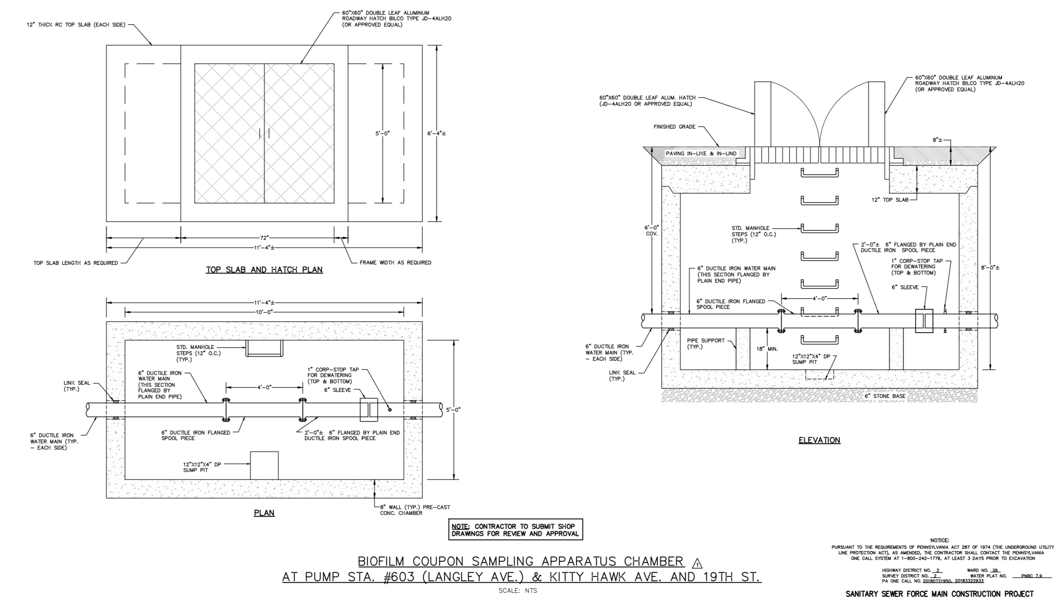

Slide 15
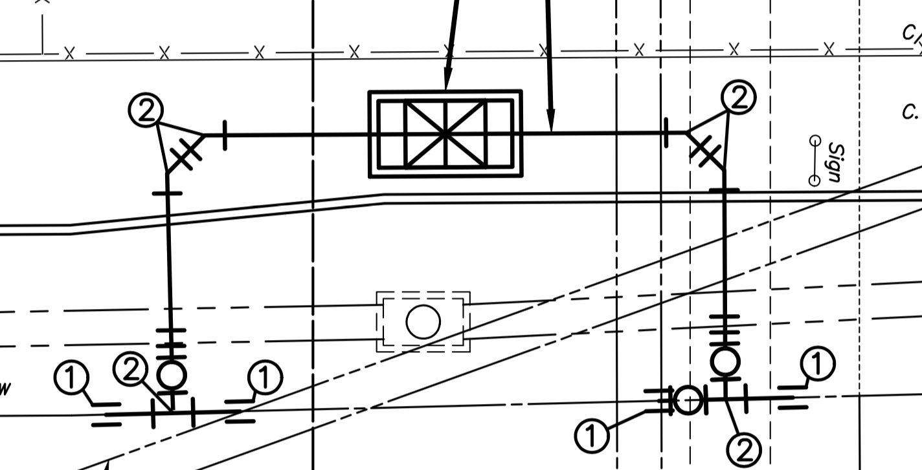

Slide 16
References
http://www.mfe.govt.nz/publications/rma/draft-users-guide-national-environmental-standard-sources-human-drinking-water/2
Gomez-Smith, K., LaPara, T. & Hozalski, R. Sulfate Reducing Bacteria and Mycobacteria Dominate the Biofilm Communities in a Chloraminated Drinking Water Distribution System. Environ Sci Technol 49, 8432–40 (2015).
Liu, S. et al. Understanding, Monitoring, and Controlling Biofilm Growth in Drinking Water Distribution Systems.Environ Sci Technol 50, 8954–8976 (2016).
Kuypers, M., Marchant, H. & Kartal, B. The microbial nitrogen-cycling network. Nat Rev Microbiol 16, 263 (2018).
Nitrification. USEPA, 2002
Deines, P. et al. A new coupon design for simultaneous analysis of in situ microbial biofilm formation and community structure in drinking water distribution systems. Appl Microbiol Biot 87, 749–756 (2010).
Douterelo, I., Jackson, Solomon & Boxall. Microbial analysis of in situ biofilm formation in drinking water distribution systems: implications for monitoring and control of drinking water quality. Appl Microbiol Biot 100,3301–3311 (2016).

